Slide 1
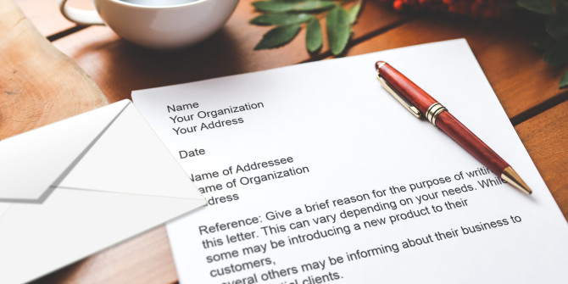
Writing Negative Letters and Messages

Slide 2
Tasks to do:
Understanding negative messages.
Three step process of developing negative messages
Four-Part Strategy/technique for Delivering Bad News sensitively.
Essentials of business messages/letters
Avoiding three causes of legal problems.
Damage control

Slide 3
What are negative messages?
The messages where the audience is expected to react in a negative manner. Negative messages consist of bad news.
The sender’s goal is to convey the bad news in a manner that preserves the business relationship.
These messages might be items such as refusal to provide a refund, cancellation of an event, inability to support an event and more.

Slide 4
Consider the message to be a negative when:
The receiver may be displeased (cost for repair is the receiver’s, not the utility company’s)
The receiver needs a little persuasion (new log-on procedure takes longer but is more secure)
The receiver may be somewhat uncomfortable (new badging system underway because employees have been sharing badges)

Slide 5
Goals in Communicating Bad News
Primary Goals:
Make the receiver understand and accept the bad news.
Maintain a positive image of you and your organization.
Secondary Goals:
Reduce the impact of bad feelings.
Convey fairness.
Eliminate future correspondence.
Avoid creating legal liability or responsibility for you or your organization.

Slide 6
The Three-Step Process
Planning
Writing
Completing
Analyze purpose/audience/
bad news itself/ anticipate
Edit, proofread, evaluate
Adapt to
the Audience
Ask: too blunt? Too subtle?
Is it clear?
Brainstorm. Strongest argument
Select Medium, approach
Compose
the Message
Format, punctuation,
correctness
Get Organized.
Develop indirect outline
Distribute Message

Slide 7
Deciding on approach:
Analyze your audience and purpose first.
DIRECT APPROACH
Anticipate the audience reaction.
Enthusiastic, Interested. Neutral.
Use it if the; 1. If the bad news is minor, not damaging or insignificant. 2. when the receiver may overlook the bad news. 3. When the organization or receiver prefers directness.
INDIRECT APPROACH
Anticipate the audience reaction.
Disappointed
Resistant
Upset

Slide 8
The Direct Approach
Flow of the Message
Bad News
Step 1
Reasons
Step 2
Positive Close
Step 3
Substance of the Message
Notes:
Direct messages take less time for you to write, and readers need less time to reach the main idea of the message. If you have chosen the direct approach to convey bad news, come right out and say it. Maintain a calm, professional tone that keeps the focus on the news and not on individual failures. If necessary, remind the reader why you are writing.
In most cases, you will follow the direct opening with an explanation of why the news is negative. The extent of your explanation depends on the nature of your news and your relationship with the reader. You will encounter situations in which explaining negative news is neither appropriate nor helpful, such as when the reasons are confidential, excessively complicated, or irrelevant to the reader. To maintain a cordial working relationship with the reader, you might want to explain why you cannot provide the information.
When a company has made a serious mistake, should an apology be offered? The best general advice (in the event of a serious mistake or accident) is to immediately and sincerely express sympathy and offer help, if appropriate, without admitting guilt; then seek the advice of your company’s lawyers before elaborating. A straightforward, sincere apology can go a long way toward healing wounds and rebuilding relationships.
After you have explained your negative news, close the message in a positive and respectful manner. If you can, consider offering your readers an alternative solution, in order to preserve an important business relationship.

Slide 9
The Indirect Approach: four main parts
Flow of the Message
Buffer:
Positive or neutral
opening that
doesn't reveal
The bad news.
Step 1
Reasons/
Explanation:
Analysis of Circumstances
& causes of
Bad news
Step 2
Implied bad
News/:
Understated expression
Of bad news.
May include alternatives
Or compromises
Step 3
Positive/
friendly
Close:
Personalized
forward looking
Pleasant statement
Step 4
Bad
News
Step 3
Positive
Close
Step 4
Substance of the Message
Notes:
The indirect approach follows a four-part sequence:
1. Open with a buffer.
2. Continue with a logical, neutral explanation of the reasons for the news.
3. Follow with a clear but diplomatic statement of the bad news.
4. Close with a positive forward-looking statement.
The next four slides cover this four-part sequence in detail.

Slide 10
Four elements strategy/ Techniques for delivering bad news in detail

Slide 11
1. Buffering the Opening (introductory paragraph)
Let the receiver know, what the message is about.
Start with the part of the message that represents the best news.
Pay a compliment, show appreciation for a past action, or refer to something mutually understood.
Avoid raising false hopes or thanking the receiver for something you are about to refuse.
Apologize if you or your company is at fault. If you do, do so sincerely and take responsibility. Mention what you are doing to compensate.
Assurance, Neutral courtesy, Agreement, Sympathy, Facts, Understanding, etc.

Slide 13
2. Presenting the Reasons (Body paragraph)
Give logical reasons, causes of bad news, all details needed, Details about requirements and what's wrong. answer all Questions.
Without revealing the refusal, explain clearly, concisely and logically why the request must be denied.
(Until our new automated system is fully online, we are still subject to human error.)
Show how your decision benefits the receiver or others, if possible.
Give fair evidence (company policy without using it as an excuse, legal aspects, desired goal, procedures, deadlines.)
Choose positive words. Avoid negative words such as cannot, claim, denied, error, failure, unwitting.
Show that the matter was treated seriously and fairly.

Slide 14
3. Implied/Cushioned Bad News. Body paragraph. The purpose is not to conceal the bad news, but to soften its impact.
Imply the refusal, but be sure it is clear. (Because we will soon be moving into new offices, all our funds are reserved for relocation costs. We hope that next year we will be able to support your worthwhile charity organization).
Mention possible future change, Compromises & alternatives.
Imbed/Sandwich bad news between other sentences- use Subordinations. (Although another candidate was hired, we appreciate your interest in our organization and wish you every success in your job search.)
Use passive voice (Cash refunds are not given because. . .).
Highlight positivity/e by describing what you can do, not what you can’t do.

Slide 15
4. Closing Pleasantly- last paragraph. The purpose of the closing is to maintain or rebuild goodwill.
Close with a pleasant statement with a sincere tone that promotes goodwill.
Offer good wishes, compliments, Sales Promotion or freebies (coupons, samples, gifts).
Avoid referring to the refusal.
Don`t invite further correspondence.
Avoid clichés i.e. If you have any questions, please don't hesitate to call.
Appreciate, look forward. Imitate to future action, show willingness to help further, Hope for improvements.
Supply more information about an alternative, if you have presented one.
(For example, in a letter rejecting a customer’s demand for replacement, you might say: I will be happy to give you a free inspection and consultation. Please call 301-746-8112 to arrange a date for my visit).

Slide 16
Sample: Refusing Typical Requests and Claims:
Parts of the Negative News Message | Example
Buffer or Cushion | Thank you for your order. We appreciate your interest in our product.
Reasons or Explanation | We are writing to let you know that this product has been unexpectedly popular, with over 10,000 requests on the day you placed your order.
Negative News | This unexpected increase in demand has resulted in a temporary out-of-stock/backorder situation. We will fulfill your order, received at 11:59 p.m. on 09/09/2009, in the order it was received.
Positive Close/ Redirect | We anticipate that your product will ship next Monday. While you wait, we encourage you to consider using the enclosed $5 off coupon toward the purchase of any product in our catalog. We appreciate your business and want you to know that our highest priority is your satisfaction.

Slide 17
Essentials of business letters.
Tone
Language
Attitude
Avoiding causes of legal problems:
Abusive and careless language.
Good-guy syndrome

Slide 18
Developing effective tone. Natural tone conveying cooperation, sincerity, courtesy.
Natural language: Simple, clear and natural. Avoid jargon.
Positive language: stress on positive rather then negative words/aspect/picture. i.e.
Negative: do not let carelessness cause accidents in the testing laboratory.
Positive: please be careful when handling explosive compounds.
4. You-attitude
Emphasize reader benefit.
Be pleasant
Appreciate and offer help if possible.
Avoid insults.
Incorrect: we are shipping your order on Friday.
Correct: you will receive your order on Monday.

Slide 19
Avoiding Three Causes of Legal Problems
1. Abusive language
Defamation Language that harms a person’s reputation
a. Libel Written/published defamation (statement)
b. Slander Spoken defamation
2. Careless language
Statements that are potentially damaging or that could be misinterpreted
Example: The factory is too hazardous for tour groups.

Slide 20
Avoiding Three Causes of Legal Problems
3. The good-guy syndrome
Dangerous statements that ease your conscience or make you look good (I thought you were an excellent candidate, but we had to hire…).
As an agent of the organization, express only views of the organization.
Avoid supplying information that could be misused.
Don’t admit or imply responsibility without checking with the organization`s policy and the legal counsel.

Slide 21
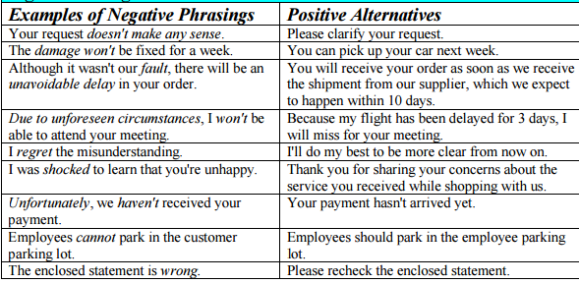
Negative vs positive language

Slide 22
Task: rewrite and improve.
Dear Mr. Ali:
We regret to inform you that we cannot allow you to convert the lease payments you have been making on your Canon X1000 color copier toward its purchase, much as we would love to. We understand that you have been making regular payments for the past 16 months.
Our established company policy prohibits such conversion of leasing monies. Perhaps you have noticed that we offer extremely low leasing and purchase prices. Obviously, these low prices would never be possible if we agreed to many proposals such as yours. Because we are striving to stay in business, we cannot agree to your request asking us to apply all 16 months of rental payments toward the purchase of our popular new equipment.
It is our understanding, Mr. Ali, that you have had the Canon X1000 color copier for 16 months, and you claim that it has been reliable and versatile. We would like to tell you about another Canon model—one that is perhaps closer to your limited budget.
Sincerely,

Slide 23
Improved.
Dear Mr. Ali:
We’re happy to learn that you are enjoying the use of the Canon X1000 color copier you’ve been leasing for the past 16 months.
Like our many other customers, Mr. Ali, you have discovered that Canon copiers supply remarkable versatility and reliability. One of the reasons we’re able to offer these outstanding copiers at such low leasing rates and equally low purchase prices is that we maintain a slim profit margin. If our program included a provision for applying lease payments toward purchase prices, our overall prices would have to be higher. Although lease payments are non-credited toward purchase price, we can offer you other Canon models that are within your price range. The Canon 600 delivers the same reliability with nearly as many features as the top-of-the-line Canon X1000.
Please let us demonstrate the Canon 600 to your staff in your office, Mr. Ali. Our representative, Kareem, will call you during the week of May 5 to arrange an appointment.
Sincerely,“

Slide 24
FREE TIP
In order to avoiding the ping-pong of communication you must ensure these two things:
The sender’s idea is clearly received by the audience
The communication provides just what the receiver needs to know: not too much and not too little
1. Avoid sarcastic and abusive language or behavior.
2. Avoid contradictions.
3. Avoid confusion or misinterpretation.
4. Maintain respect and privacy.

Slide 25
Sample scenarios
1. A community disaster such as illness (e.g., a swine flu epidemic), earthquake, wildfire, plane crash, or a terrorism incident.
2. An on-the-job accident with injuries or even death
3. A product defect resulting in injuries, illness, or even death to consumers
4. An unsuccessful product test (e.g., a new software system that isn’t going to be ready for launch
as planned)
5. A company merger that may result in reductions in force or layoffs

